Slide 1
ISUAL TUDIO CODE A Practical Case Study
V
S
Presented By:
Darshan Pathak

Slide 2
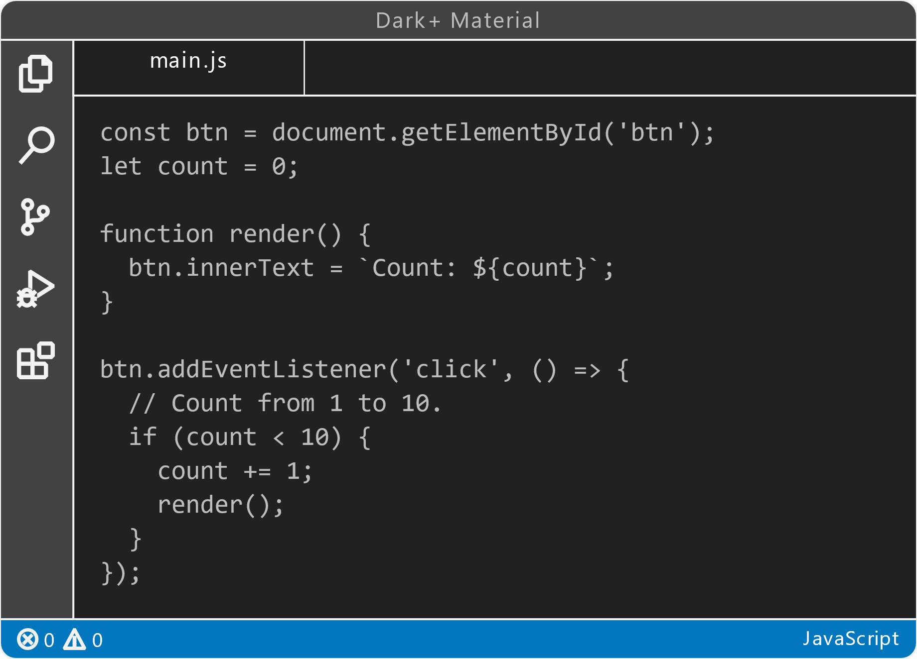
WHY isual tudio CODE
V
S
VS Code is one of the most widely used code editors in the software development industry.
VS Code is a powerful tool for your coding and development needs.

Slide 3
03
01
02
04
About the Topic
TABLE OF CONTENTS
05
Conclusion
Introduction
Key Features
06
Practical Case Study
Advantages &
DisAdvantages

Slide 4
TABLE OF CONTENTS
01
03
02
04
05
Introduction
About the Topic
Conclusion
06
Key Features
Advantages &
DisAdvantages
Practical Case Study

Slide 5

INTRODUCTION
Visual Studio Code, commonly known as VS Code, is a free, open-source code editor developed by Microsoft.
It has gained immense popularity among developers due to its versatility, extensions, and ease of use.
VS Code is designed to work with a wide range of programming languages, making it suitable for various development projects.

Slide 6



KEY FEATURES
Extensiblity
Git Integration
Snippets
Wide variety of extensions
Alloes to Work with Git Version Control
Provides predefined and custom code snippets to write code faster.

Slide 7
KEY FEATURES
Language support
Intelli-Sense
Debugging Support
Supports Wide variety of Languages
Automatic declaration of code
Robust debugging experience

Slide 8


ADVANTAGES
Task Automation
Free & Open Sourse
Cross Platform
Light Weight
Fewer Resource Consumption
Defining and running various project specific processes
Consistancy across different operating systems
Free to use.
view,read modify sourse code

Slide 9
ADVANTAGES
LightWeight
Task Automation
Cross Platform
Free & Open Sourse
Fewer Resource Consumption Making it
Fast and Responsive
Defining and running various project specific processes
Consistancy across different operating systems
Free to use.
view,read modify sourse code

Slide 10


DISADVANTAGES
Learning Curve
Limited Features
Less Stable
Not as feature rich as other IDEs
Can be challenging for beginners
Performance issues while working with large projects

Slide 11

PRACTICAL CASE STUDY: BUILDING A WEB APPLICATION

Slide 12

Solution
Problem
This can be done using VS Code
Building a simple web application using HTML, CSS and JavaScript

Slide 13
PROCESS
Step 2
Step 1
Step 3
Step 5
Step 4
Step 6
Creating Project Files and Folder Structure
Setting up the environment
Writing Code and Preview Real Time Changes
Initialize Git Repository for Version Control
Debugging
Deployment of the web application

Slide 14
PROCESS
Step 1
Step 2
Step 3
Step 4
Step 5
Step 6
Setting up the environment
Creating Project Files and Folder Structure
Writing Code and Preview Real Time Changes
Initialize Git Repository for Version Control
Testing & Debugging
Deployment of the web application

Slide 15

CONCLUSION
Visual Studio Code is a powerful and versatile code editor with a robust set of features.
Its advantages include being lightweight, cross-platform, and highly extensible.
While it may lack some advanced features and have a learning curve, it remains a top choice for developers across the globe.
___

Slide 16
THANK YOU!
THANK YOU!
Please, keep this slide for attribution.

